Slide 1

SQL LIBRARY MANAGEMET PROJECT

Slide 2
AIM
To design and implement a Library Management System using SQL that efficiently manages library operations, tracks book inventory, member activities, borrowing and returning processes, and provides insightful KPIs to optimize library performance.

Slide 3
OBJECTIVES
Create a structured database to store and organize library information.
Track the availability and borrowing status of books in real time.
Maintain detailed records of library members and their borrowing history.
Automate the process of tracking borrowed books, due dates, and returns.
Manage and store details of library staff.
Provide actionable insights through KPIs like borrowed books, overdue books, and membership growth.
Enhance decision-making by analyzing borrowing patterns and book availability.
Identify overdue books to notify members promptly.
Generate monthly reports on membership growth, borrowing trends, and book inventory.
Ensure scalability and flexibility to accommodate growing data and future system enhancements.

Slide 4
KPI
Total Books Issued
Total number of books currently borrowed by members.
Most Borrowed Book
The book that has been borrowed the most times.
Total Active Members
Total number of active library members.
Book Availability by Genre
Number of available copies of books categorized by genre.
Overdue Books
Number of books that are overdue for return.
Books Availability Ratio
Percentage of available copies compared to the total number of copies in the library.
Books Borrowed by Each Member
The number of books each member has borrowed.
Monthly Membership Growth
Number of new library members per month.

Slide 5
QUERIES & RESULTS

Slide 6
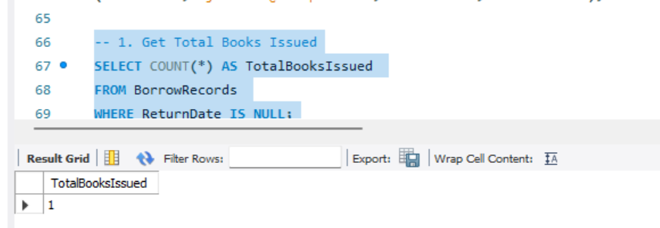

Slide 7
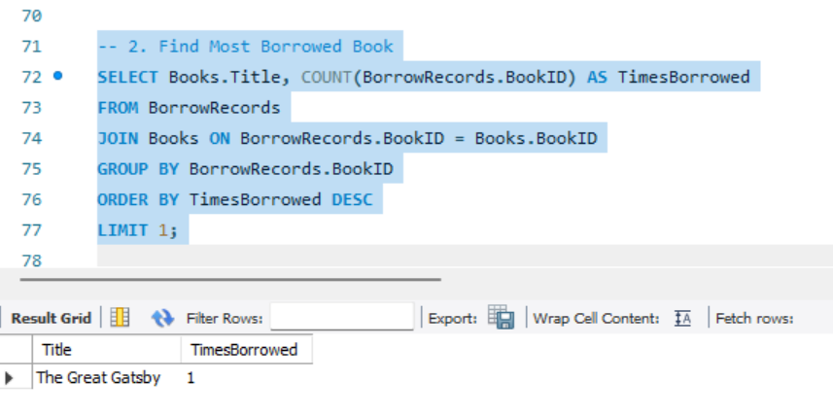

Slide 8
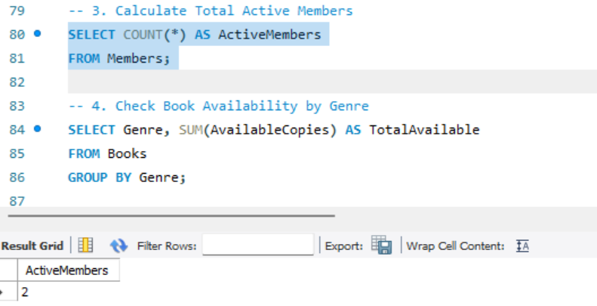

Slide 9
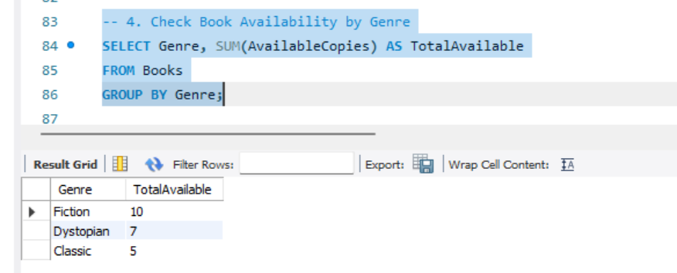

Slide 10
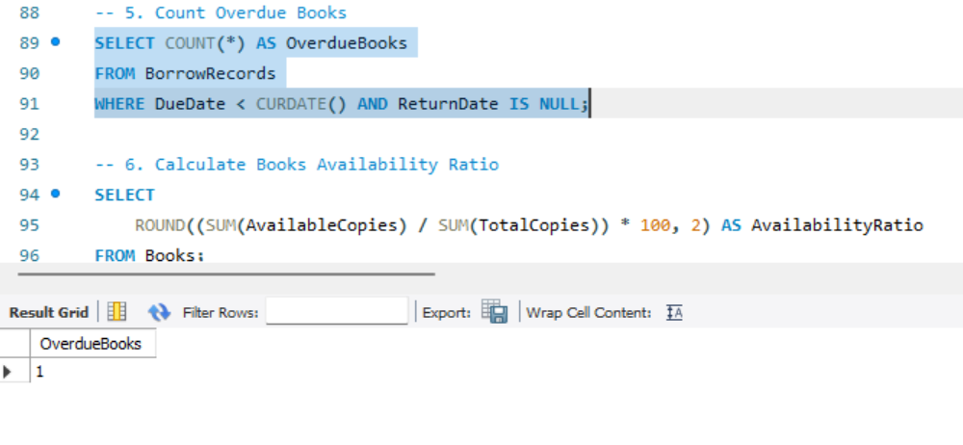

Slide 11
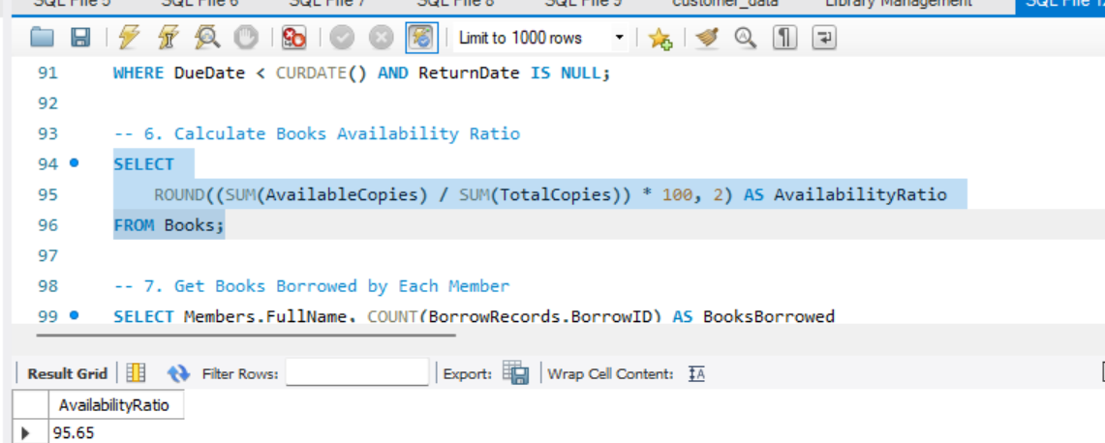

Slide 12
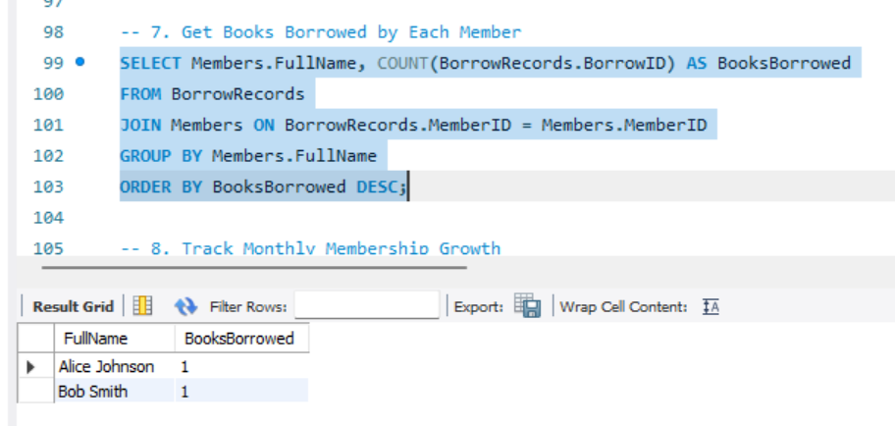

Slide 13
